Slide 1

Based on the new
2025 ILCOR/ECC Guidelines
Notes:
Welcome to the Emergency Care & Safety Institute 2026 Instructor Guideline Update.

Slide 2
Contents
ILCOR Overview
  General
  Task Forces
  CoSTRs
  ECC Guidelines
ECC Guideline Updates
ECSI Updates
Notes:
In this course, we will be reviewing the 2025 updates to the International Liaison Committee on Resuscitation’s Consensus on Science with Treatment Recommendations and the related Emergency Cardiovascular Care Guidelines from the American Heart Association. As ECSI courses are built using these guidelines, we will also discuss changes to the core ECSI courses that instructors should be aware of. We will also outline some of the global updates being implemented in the current ECSI programs. Finally, we will go over ECSI program releases and changes to the ECSI Instructor Development Course.

Slide 3
ILCOR Overview: General
International Liaison Committee on Resuscitation (ILCOR)
Established in 1992
Serves as a global forum for resuscitation organizations
  10 resuscitation councils
Focus on promoting, disseminating, and advocating for the international implementation of evidence-based resuscitation, first aid, and emergency care
Notes:
First, let’s review what the International Liaison Committee on Resuscitation is and what it does, the Consensus on Science with Treatment Recommendations development process, and the Emergency Cardiovascular Care Guidelines that stem from it.
The International Liaison Committee on Resuscitation, or ILCOR, was established in 1992 and is a collaboration of global resuscitation councils and organizations. Its mission is to save lives by promoting, distributing, and advocating for evidence-informed emergency care worldwide.

Slide 4
ILCOR Overview: Task Forces
ILCOR operates through six Task Forces:
  Basic Life Support (BLS)
  Advanced Life Support (ALS)
  Pediatric Life Support (PLS)
  Neonatal Life Support (NLS)
  Education, Implementation, and Teams (EIT)
  First Aid
Notes:
ILCOR has six Task Forces that are made up of expert representatives from its member organizations. These Task Forces review scientific research in the areas listed here.

Slide 5
ILCOR Overview: CoSTR
Consensus on Science with Treatment Recommendations (CoSTR)
Summaries published yearly; comprehensive updates published every 5 years
  Updates to treatment recommendations based on most current research
Notes:
On a regular basis, Task Force members rigorously evaluate and debate the scientific research available for their specific areas. They then come to a consensus on what that science means for patient care based on the quality and strength of that science. Each consensus aids in creating treatment guidelines by providing actionable recommendations for providers and is referred to as the Consensus on Science with Treatment Recommendations, or CoSTR.
Due to the rapid pace of scientific and technological change, research is continuously reviewed, with annual update summaries published to reflect new evidence, changes in treatment recommendations, and gaps in knowledge. Every five years, a comprehensive update compiles topics reviewed since the previous full report and provides detailed discussion of the evaluation process, methodology, and potential conflicts of interest. This course will discuss the 2025 comprehensive update, which covers all updates since the last comprehensive update in 2020.

Slide 6
ILCOR Overview: ECC Guidelines
Emergency Cardiovascular Care (ECC) Guidelines
Created by the American Heart Association based on science in CoSTR
  Focus on improving outcomes after cardiac arrest and airway obstruction
Notes:
From the CoSTRs, each member organization of ILCOR creates their own the set of guidelines. In the United States, the American Heart Association publishes their Guidelines for Cardiopulmonary Resuscitation and Emergency Cardiovascular Care (ECC) in their journal, Circulation, usually at the same time as the CoSTRs.
As suggested by the title, these Guidelines focus on improving outcomes from cardiac arrest. While these Guidelines are based on ILCOR’s recommendations, the updates are not always exactly the same; the Guidelines use the science in the CoSTR to direct implementation. ECSI courses are based on ILCOR’s CoSTR and are consistent with ECC guidelines. We will discuss relevant updates to ECSI materials based on the new CPR and ECC guidelines.

Slide 7
CoSTR Updates: Resuscitation
CAB vs. ABC in adults in cardiac arrest from drowning
  Lay rescuers: compression first (CAB)
  Health care and other trained professionals: rescue breaths/ventilation first
Notes:
Now that you have an understanding of the scientific basis for ECSI courses, let’s go through the updates. Many of the updates in both the CoSTRs and ECC Guidelines are related to advanced life support or in-hospital care, which are beyond the scope of ECSI’s courses. This course will be focusing on changes that are relevant for ECSI.
Note that some of these recommendations may seem familiar. This is because the authors of ECSI’s texts follow the yearly updates and include new guidance as it is released. As such, some of the updates discussed here may have already appeared in previous editions of ECSI course material.
Let’s start with CoSTR updates related to resuscitation. For adults who have gone into cardiac arrest following a drowning incident, the CoSTR recommends that first aid providers use a compression-first strategy, while health care professionals and those who have training and a duty to respond, such as lifeguards, start with rescue breaths. This update is designed to streamline training for first aid providers and take advantage of the specialized training of health care professionals and lifeguards.

Slide 8
CoSTR Updates: Resuscitation
CPR in patients with obesity
  Standard CPR protocols should be used
Notes:
For people with obesity, no evidence was found to suggest that changes to CPR protocols are necessary. As such, standard CPR techniques should be used in this population.

Slide 9
CoSTR Updates: Resuscitation
CAB vs. ABC in children
  Both approaches are acceptable
  Breaths are an important component
Notes:
For children in need of CPR, there is no evidence to support an optimal order for breaths and compressions, so ECSI will continue to utilize the RAB-CAB, approach. However, the CoSTR does state that breaths are an important component of CPR for children; this will also be discussed later in this course as part of the ECC guideline updates.

Slide 10
CoSTR Updates: Resuscitation
Pulse checks in children
  Both first aid providers and health care professionals should begin CPR in unresponsive children who are not breathing normally and show no signs of life without first checking for a pulse
Notes:
While first aid providers are taught to begin CPR in all unresponsive persons who are not breathing normally, previous guidance stated that health care professionals should not begin CPR unless they do not feel a pulse after 10 seconds of checking. In the 2025 CoSTR update, health care professionals should no longer check a pulse; rather, they should begin CPR if the child is unresponsive, not breathing normally, and shows no signs of life, the same as first aid providers.

Slide 11
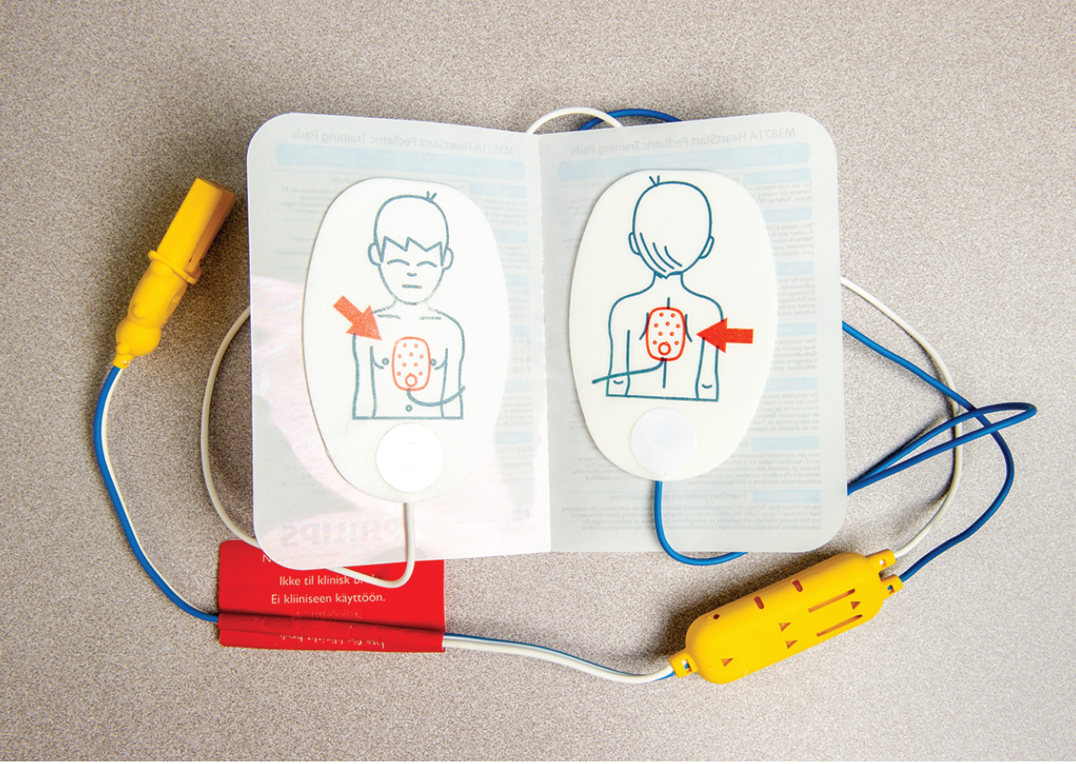
CoSTR Updates: Defibrillation
AED pad placement
  Follow AED manufacturer’s guidance for pad placement
© Jones & Bartlett Learning
Notes:
For AED users, the CoSTR recommends following the manufacturer’s guidance for pad placement. The recommendation also instructs AED manufacturers to standardize pad placement and provide clear instructions and diagrams illustrating the proper location for pad placement for adults, children, and infants.

Slide 12

CoSTR Updates: Defibrillation
Bra removal before defibrillation
  Recommendation is to reposition as necessary rather than completely remove to ensure pads contact the skin
© Jones & Bartlett Learning
Notes:
There is insufficient evidence to support routine removal of bras, and repositioning may be all that is needed to ensure correct pad placement. The CoSTR recommends that manufacturers develop manikins in a wider range of body shapes that can impact pad placement. In addition, CPR and AED training should include defibrillation of people wearing bras to ensure correct pad placement, limited interruptions in compressions, and timely AED use. This shift in training can potentially help overcome hesitancy and improve AED usage on women.

Slide 13
CoSTR Updates: First Aid
Manual uterine massage for postpartum hemorrhage
  Suggest external uterine massage, including self-massage, in the immediate postpartum period
Notes:
Now we will discuss updates to CoSTR recommendations related to first aid.
External uterine massage is recommended immediately after birth to prevent postpartum hemorrhage, which is a significant cause of morbidity and mortality. This can be either self-massage or performed by another person.

Slide 14
CoSTR Updates: First Aid
Unintentional injury from providing chest compressions to patients who are not in cardiac arrest
  Recommend that all responders initiate CPR for presumed cardiac arrest without concerns for causing unintentional injury
Notes:
Because the potential survival benefits of CPR in persons in cardiac arrest outweigh the potential risks of injury of CPR in persons not in cardiac arrest, the CoSTR recommends that CPR be initiated in all cases of presumed cardiac arrest without concerns for possible unintentional injury. This applies to both layperson first aid providers and health care professionals.

Slide 15
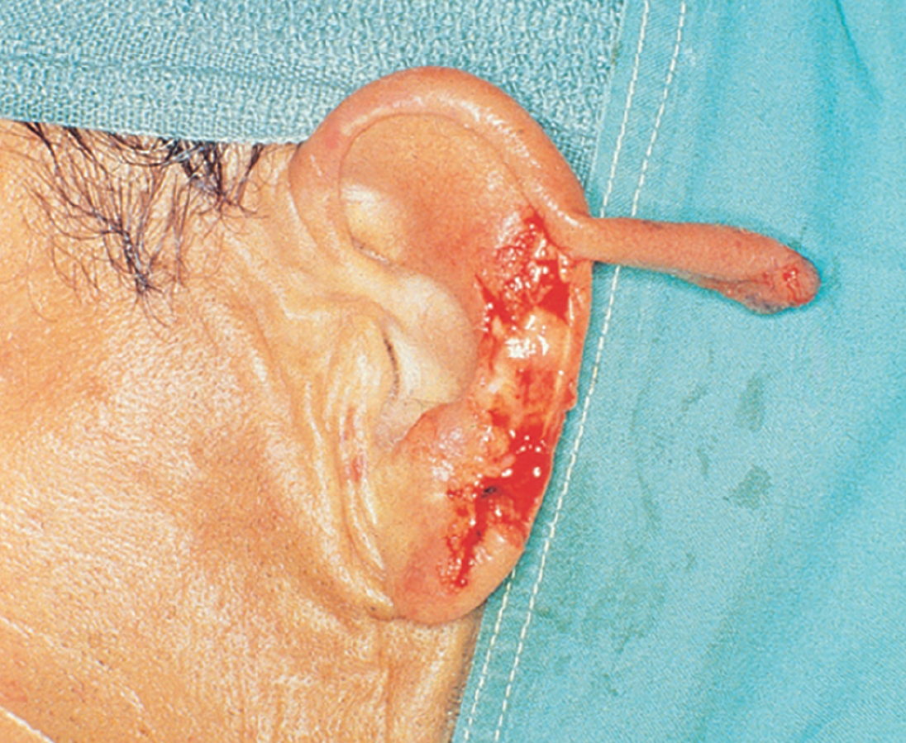
CoSTR Updates: First Aid
Preservation of traumatic, completely amputated or avulsed parts
  Success in replantation is time dependent
  Amputated parts should be cooled (without freezing) as soon as possible
© American Academy of Orthopaedic Surgeons
Notes:
The priority in traumatic amputation or avulsion is always to care for the injured person, such as controlling bleeding. However, because success in replantation is time dependent, the amputated or avulsed body parts should be retrieved and transported a quickly as possible, preferably to the same facility as the injured person. Outcomes may be improved by cooling without freezing as soon as possible and throughout transport.

Slide 16
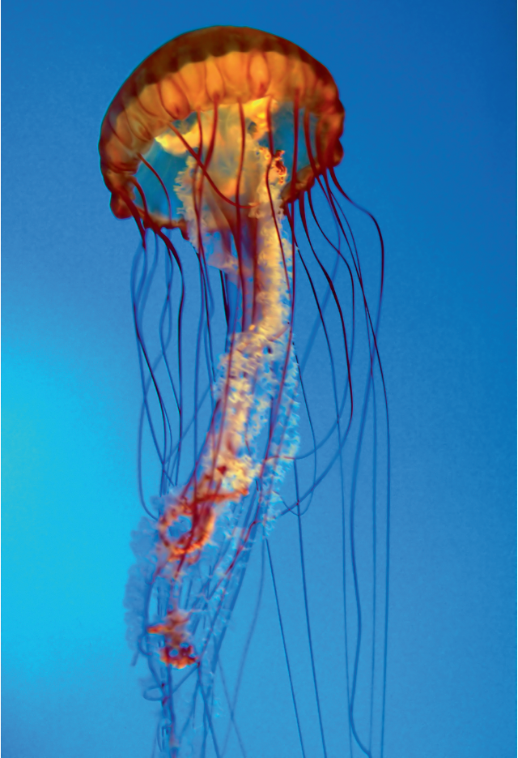
CoSTR Updates: First Aid
Treatment of jellyfish stings
  Recommend rinsing the area of the sting with seawater, then using heated water (104–113ºF [40–45ºC) immersion, irrigation, or shower, or hot pack application for pain
  Recommend against the use of topical 10% ammonia, isopropanol or ethanol for treatment
© Real Deal Photo/Shutterstock
Notes:
Effective treatment for jellyfish stings may vary by species, but because it is not feasible for first aid providers to be able to identify all jellyfish, general guidance was needed. Seawater is recommended to rinse the area initially to remove tentacles and nematocysts that are stuck to the skin. Once the area has been cleared, heated (non-scalding) water should be applied to help with pain. Topical use of 10% ammonia, isopropanol, or ethanol is not recommended, as use was shown to either increase pain or be less effective than seawater.

Slide 17
CoSTR Updates: Education
CPR education tailored for specific populations
  Encourage development of tailored BLS courses for specific populations based on specific needs and educational approach
Notes:
The last of the CoSTR updates will be covering topics related to education that may be of use for Education Centers and instructors to consider implementing.
To increase the numbers of trained laypersons who are willing to provide CPR, it is recommended that courses be tailored to specific populations that have otherwise not been targeted. This may include children and people with disabilities, among many others.

Slide 18
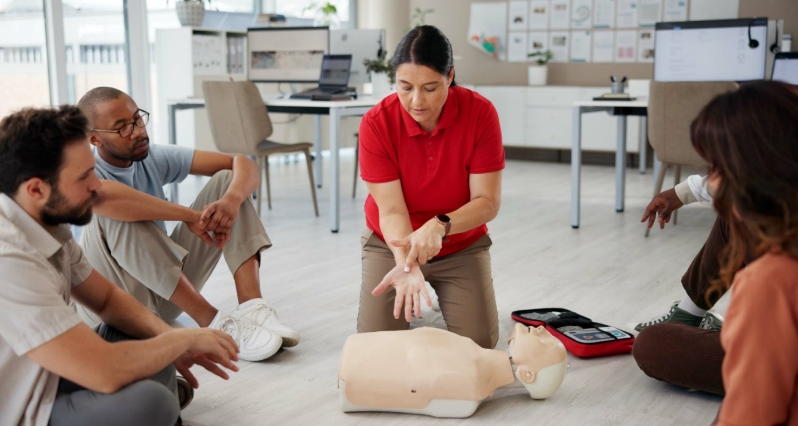
CoSTR Updates: Education
Willingness to provide CPR/AED
  Encourage providing easy access to BLS courses, raising awareness about cardiac arrest and its treatment, and utilizing training, public outreach, and social media to increase laypersons’ willingness to perform CPR
© Shutterstock/PeopleImages.com - Yuri A
Notes:
Related to the update just discussed, the CoSTR also recommends raising awareness of and access to basic life support courses through various channels to increase the number of laypersons willing to perform CPR. This may include public outreach and social media campaigns.

Slide 19
CoSTR Updates: Education
CPR feedback device use
  Recommend use of CPR feedback devices during resuscitation training for health care professionals and laypersons
Notes:
To improve the quality of CPR, it is recommended to use CPR feedback devices during training to ensure correct compression depth, compression rate, and chest recoil. While the effect appears to be higher when used in professional training, feedback devices use in layperson training also resulted in improved metrics and showed no undesirable effects.

Slide 20
CoSTR Updates: Education
Manikin fidelity
  Suggest using high-fidelity manikins when the infrastructure and resources support them
Notes:
Use of high-fidelity manikins in CPR training is recommended for training centers that have the resources to support their use. This recommendation is limited to those organizations able to bear the higher costs related to the purchase and maintenance of high-fidelity training manikins. Where high-fidelity manikins are not available or feasible, low-fidelity manikin use is acceptable for training purposes.

Slide 21
ECC Guideline Updates
Chain of survival
  Consolidated into a single, six-link chain
Recognition and emergency activation
High-quality CPR
Defibrillation
Advanced resuscitation
Post-cardiac arrest care
Recovery and survivorship
Notes:
We will now move on to discussing the updates to the emergency cardiovascular care, or ECC, Guidelines that are relevant to ECSI course materials. As previously discussed, the American Heart Association creates the ECC Guidelines based on ILCOR’s CoSTR for use by health care professionals and laypersons in the United States.
The first update relates to the Chain of Survival, which illustrates the actions that must be taken to maximize survival from cardiac arrest. Previously, there were four different chains to represent adult, pediatric, in-hospital, and out-of-hospital cardiac arrest. These have now been consolidated into one six-link chain. (Neonatal resuscitation is considered separate and has its own Chain of Care, but this is beyond the scope of ECSI courses.)

Slide 22
ECC Guideline Updates
Emphasis of breaths with chest compressions in children
  Best outcomes are with conventional CPR (compressions and breaths)
  Compression-only CPR is better than no CPR
Notes:
Compression-only CPR is an important part of CPR training, as it may help to increase bystander willingness to help a person in cardiac arrest. However, because respiratory failure is a major cause of cardiac arrest in children and infants, compression-only CPR is not recommended for those populations. Conventional CPR—that is, CPR with both compressions and breaths—should be provided for children and infants, and should be emphasized in first aid training. However, if first aid providers are unwilling or unable to provide rescue breaths, compression-only CPR has been shown to produce better results than no CPR at all.

Slide 23
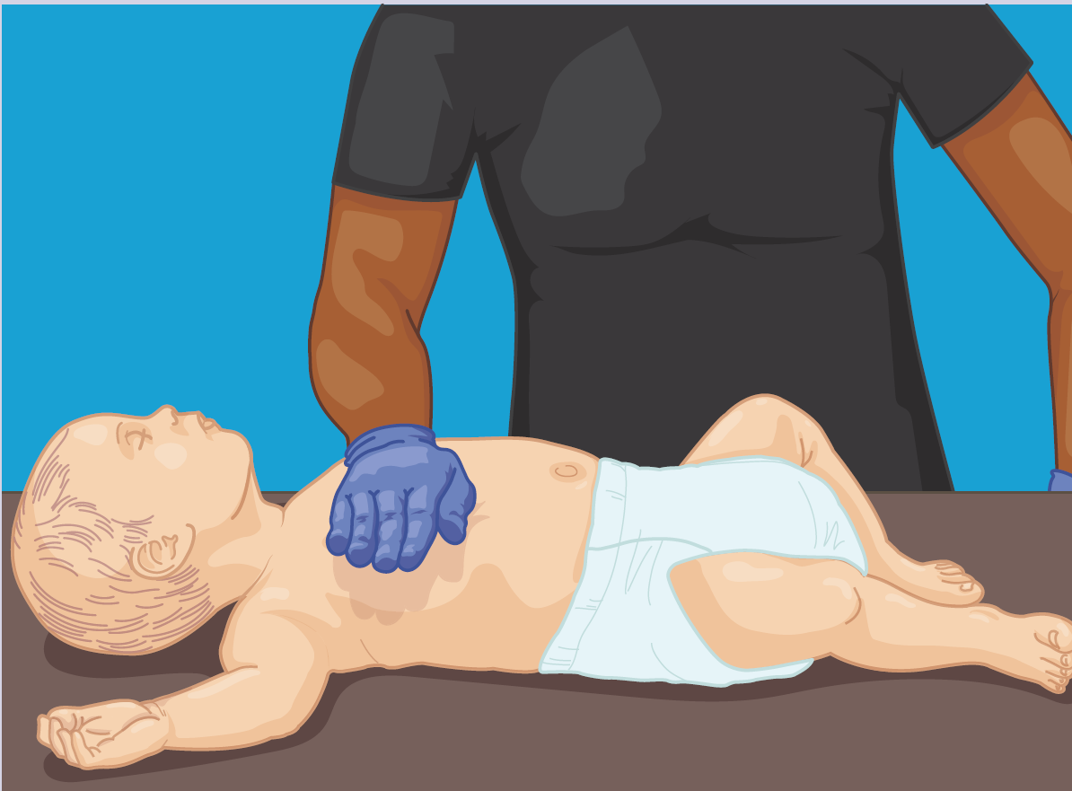
ECC Guideline Updates
Chest compressions in infant CPR and airway obstruction
  Elimination of two-finger technique; replaced with heel-of-one-hand technique
© Jones & Bartlett Learning
Notes:
Previously, the recommended compression techniques for infant CPR and airway obstruction were the two-thumbs/encircling hands technique and the two-finger technique. However, studies have shown that the two-finger technique is less likely to achieve adequate compression depth, so it has been replaced with the heel-of-one-hand technique.

Slide 24
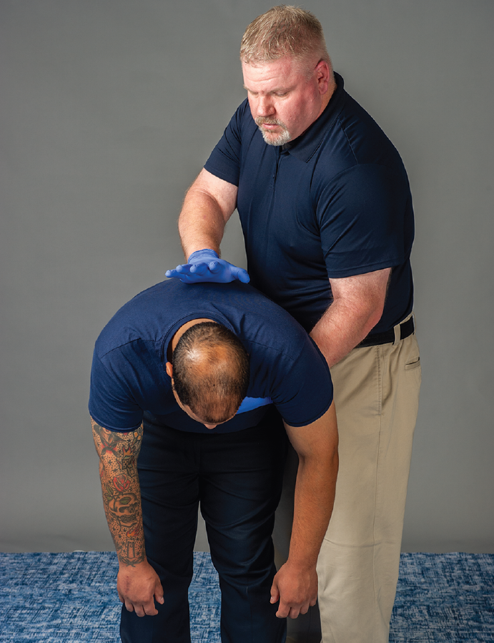
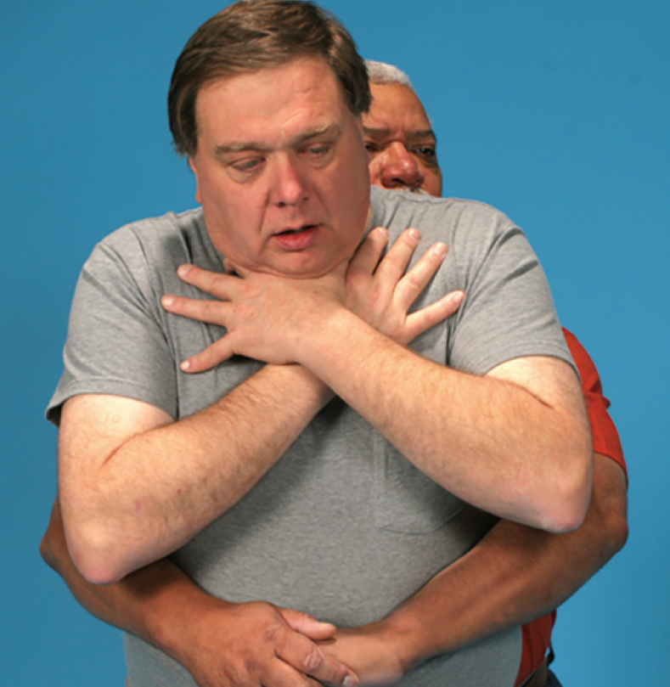
ECC Guideline Updates
Airway obstruction: Adults and children
  Suggested management of severe airway obstruction in adults and children is cycles of five back blows, followed by five abdominal thrusts, repeated as necessary.
© Jones & Bartlett Learning
Notes:
Management of severe foreign body airway obstruction in conscious persons in all populations now begins with five back blows. In adults and children, this is followed by five abdominal thrusts, and the cycle is repeated until the object is dislodged or the person becomes unconscious.

Slide 25
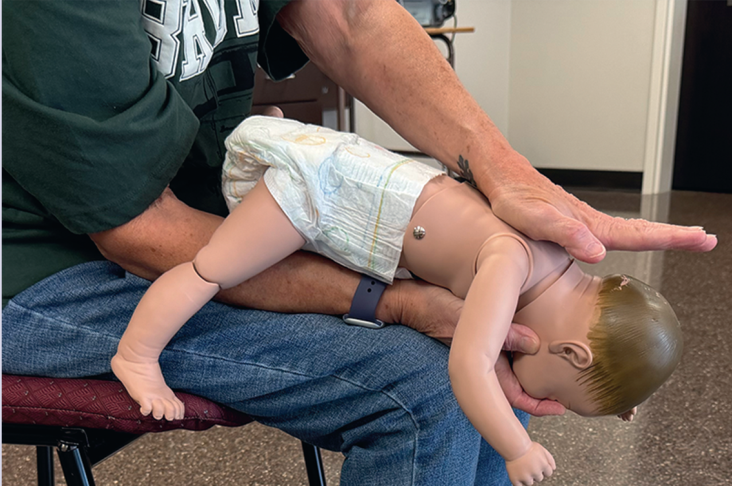
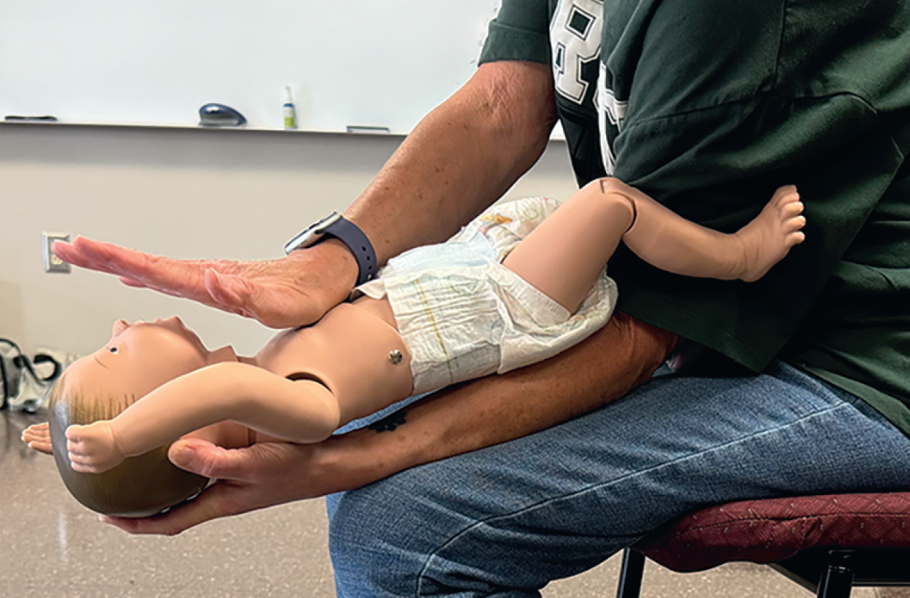
ECC Guideline Updates
Airway obstruction: Infants
  Suggested management of severe airway obstruction in infants is cycles of five back blows, followed by five chest thrusts, repeated as necessary.
Courtesy of Rhonda Hunt
Notes:
As with adults and children, management of severe airway obstruction in a conscious infant begins with five back blows, followed by five chest thrusts, with alternating cycles of back blows and chest thrusts provided until the object becomes dislodged or the infant becomes unconscious. Remember that chest thrusts are now performed using the heel-of-one-hand technique, not the two-finger technique.

Slide 26
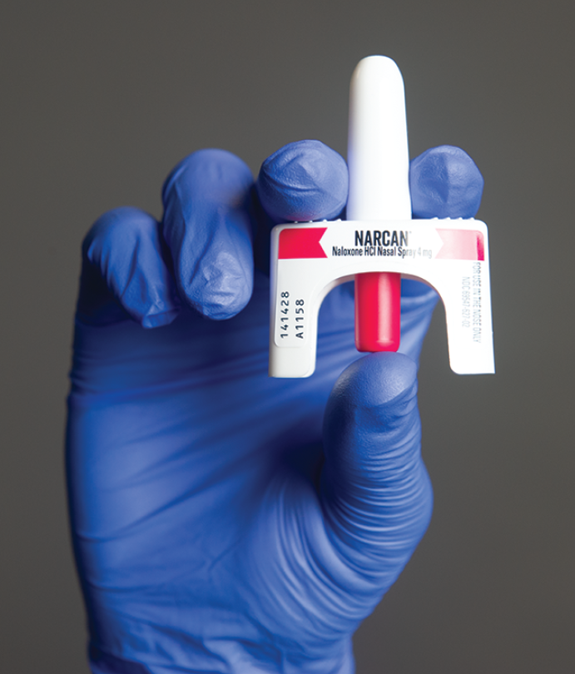
ECC Guideline Updates
Naloxone administration
  Lay rescuers should administer naloxone in cases of respiratory/cardiac arrest from suspected opioid overdose
© Jones & Bartlett Learning
Notes:
The administration of naloxone in cases of respiratory and cardiac arrest in which opioid overdose is suspected has been added to the adult basic life support algorithm. Administration can be performed by trained rescuers, laypersons, and the general public. The ECC Guideline also recommends policies that support public access to naloxone.

Slide 27
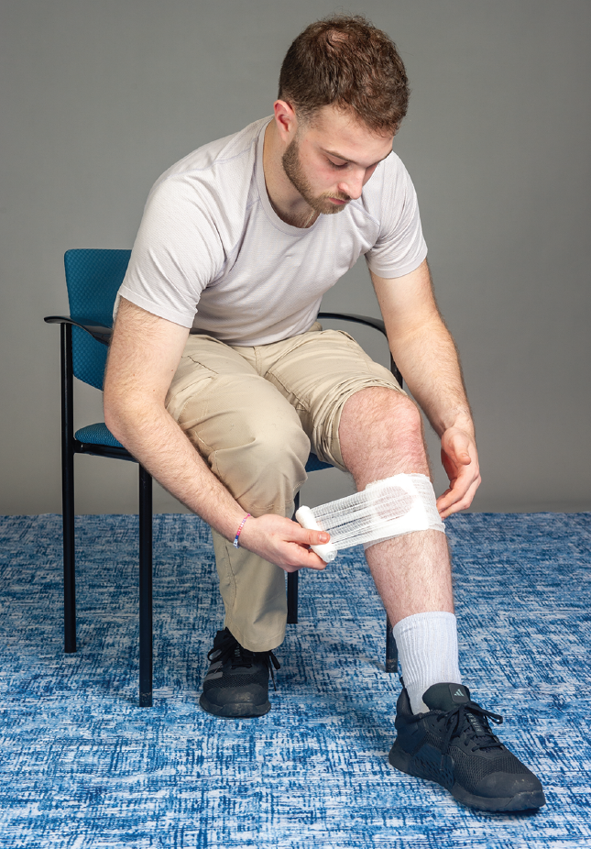
ECSI Updates: Global
Communicating with ill/injured persons
Emotional considerations
Assessment in darker skin tones
Pediatric considerations
Shock in injured persons
Manufactured vs improvised tourniquets
Self-care techniques
Meets the following:
  ILCOR CoSTRs
  ECC Guidelines
  Stop the Bleed campaign
© Jones & Bartlett Learning
Notes:
Next we’ll be covering global changes being made to ECSI training materials. These updates are in response to customer feedback and to better align with current best practices in emergency medicine education.
Additional content on communication skills and emotional resilience has been added to improve first aid providers’ confidence in their ability to care for others and themselves during stressful incidents involving an illness or injury. Assessment of darker skin tones and treatment considerations specific to children and infants have been updated, and new content on shock in injured persons is provided. In accordance with the Stop the Bleed campaign, the importance of manufactured tourniquets as a critical part of any first aid kit is emphasized. Finally, content on self-first aid has been added, with specific focus on self-application of a tourniquet.

Slide 28
ECSI Updates: Program Releases
Live:
  Instructor Development Course
  Standard First Aid, CPR, and AED Ninth Edition
To come 2026:
  First Aid, CPR, and AED Guide Ninth Edition
  CPR and AED Ninth Edition
  Basic Life Support Seventh Edition
To come 2027:
  Advanced First Aid, CPR, and AED Ninth Edition
  Wilderness First Aid: Emergency Care in Remote Locations Seventh Edition
  Wilderness First Aid Guide Fourth Edition
Notes:
The ECSI Instructor Development Course and the Standard First Aid, CPR, and AED Ninth Edition product suite are currently live and available for purchase. ECSI programs releasing later in 2026 and 2027 include those listed here.

Slide 29
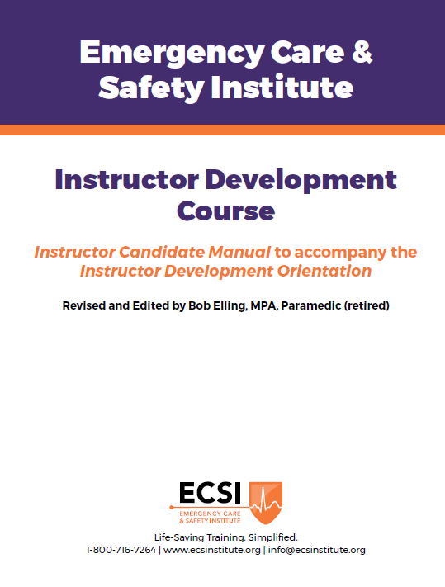
ECSI Updates: Instructor Development
Instructor Development Course (IDC)
  Instructor Development Orientation (IDO)
  Education Center Orientation (ECO)
  Monitored Teaching Experience (MTE)
Notes:
Finally, let’s go over some of the recent changes to ECSI instructor development. The ECSI Instructor Development Course has been redesigned into three separate components: the Instructor Development Orientation, the Education Center Orientation, and the Monitored Teaching Experience. Materials for the Instructor Development Orientation and the Education Center Orientation have been thoroughly updated and streamlined to better prepare Instructor Candidates for the vital role of an ECSI Instructor.

Slide 30
For More Information
2025 CoSTR document
2025 ECC document
ECSI Blog: Understanding Guidelines
Notes:
This course was designed to provide an overview of the CoSTR and ECC updates that directly impact ECSI course content. For more information on additional recommendations—including methodologies and detailed reference lists—you can access the complete documents using the links on the screen. A brief discussion of the guideline updates, including those not covered in this course, is also available in an ECSI blog post by Bob Elling, also linked on screen.

Slide 31

Thank you!
For questions, please email info@ecsinstitute.org
Notes:
Thank you for completing this course outlining the new guideline updates! We appreciate your dedication to lifelong learning and staying up-to-date on the latest research and recommendations.
If you have any questions about this course, guidelines, or ECSI programs, please contact us at info@ecsinstitute.org. Thank you.

